Slide 1
Trees & Binary Trees

Slide 2
Overview
Trees Ch 10.4, 12.1
Representing rooted trees
Binary trees Ch 12.2–3

Slide 3
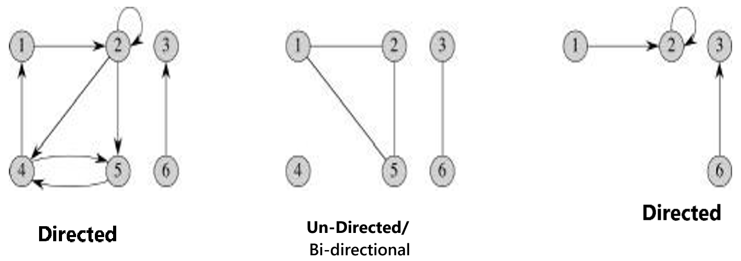
Graphs
Graphs have vertices (nodes) connected by edges .
Graph, G = (V , E)
^{In graph,}
  ^{node = Vertex,}
  ^{nodes = vertices}
  connection/link between 2 nodes = edge
¹Cormen, Leiserson, Rivest, Stein. Introduction to Algorithms, 3rd edition, MIT Press, 2009
Trees Ch B.5, 10.4, 12.1

Slide 4
Graphs
Directed graphs:
edges have direction (one-way streets)
Undirected/Bi-directional graphs:
edges have no direction (two-way streets)
Image:¹
^{In graph,}
^{node = Vertex,}
^{nodes = vertices}
connection/link between 2 nodes = edge
¹Cormen, Leiserson, Rivest, Stein. Introduction to Algorithms, 3rd edition, MIT Press, 2009
Trees Ch B.5, 10.4, 12.1

Slide 5
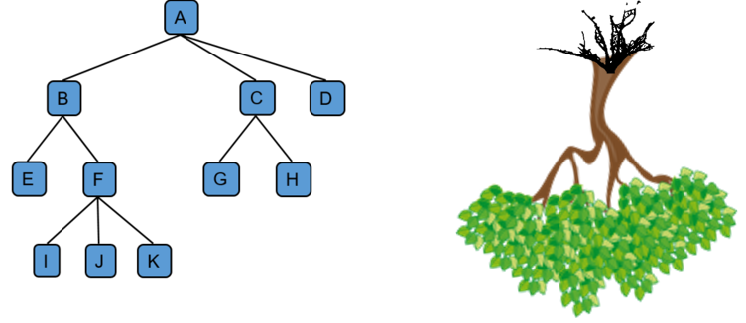
Trees and forests
Trees are graphs with special properties
Tree is a non-linear data structure that allows us to organize, access and update data efficiently by representing non-linear data in a form of hierarchy.
A graph that contains a cycle is never a tree (Cycle will be covered later)
Image: https://sites.ualberta.ca/~rosanna/books/PDSA/chapter8/tree.html
Trees Ch B.5, 10.4, 12.1

Slide 6
Trees and forests
Applications of tree
Continuous Sorting with Trees: Using a Binary Search Tree (BST), new data can be inserted in a sorted manner without re-sorting the entire array.
Folder/File System: A tree structure represents folders (branches) and files (leaf nodes) in a system, with the desktop as the root.
Electrical Circuit Design: Trees model electricity distribution from a central point to homes and industries.
Network Routing: Trees are used to determine efficient routes for data packets in computer networks.
Trees Ch B.5, 10.4, 12.1

Slide 7
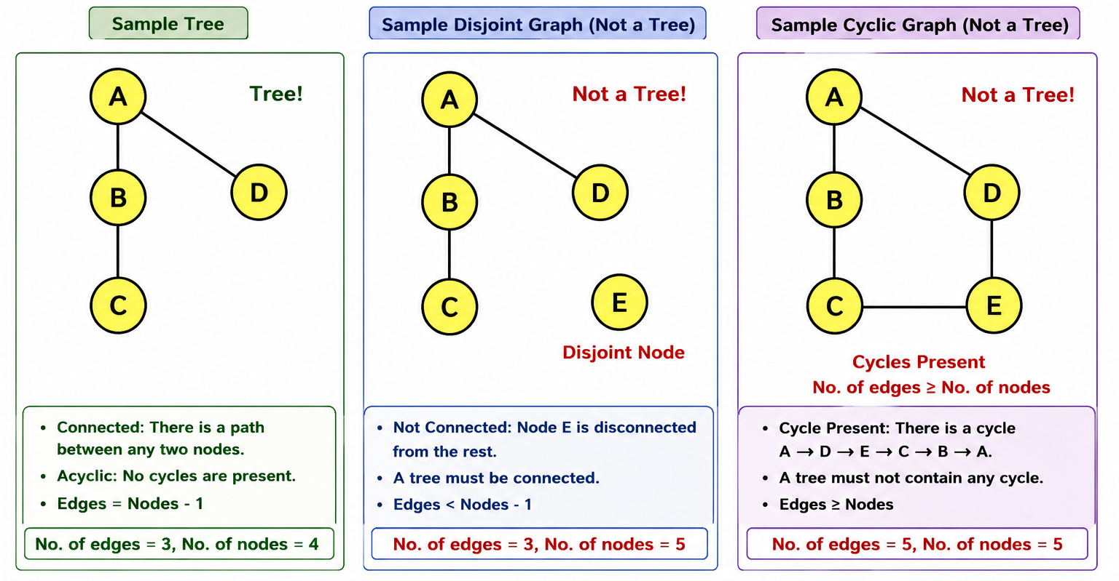
Trees
The most general type of tree
is a free tree (or tree)
Properties of free trees/tree:
  Unique path: Any two vertices in a free tree are connected by a unique path
  Connected (continuous and not disjoint):
    If a single edge is removed from a free tree, it becomes disconnected.
    Every single node must be traversable starting from the root node.
  Acyclic: If any edge is added to a free tree, it becomes a graph with a cycle (no longer a tree).
    If there is a cycle in a graph, then no of edges >= no of nodes
    A tree with n nodes will have n or more edges if it has cycles.
    For a tree, no of edges == no of nodes - 1.
Trees Ch B.5, 10.4, 12.1

Slide 8
Trees
Properties of free trees/tree: (Important)
For a tree with n nodes, the number of edges is always n − 1.
  More than n − 1 edges → creates at least one cycle.
  Fewer than n − 1 edges → the graph becomes disconnected.
Trees Ch B.5, 10.4, 12.1

Slide 9
Trees
Trees Ch B.5, 10.4, 12.1

Slide 10
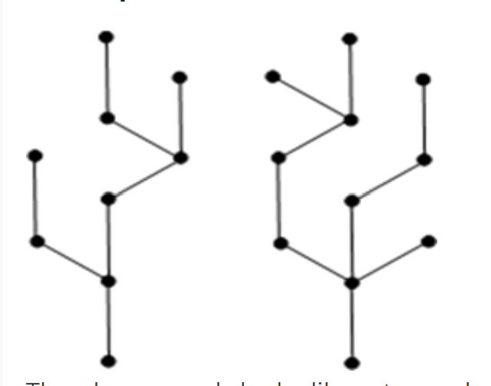
Forests
Forest: Forest is a disjoint collection of trees
  Each component of a forest is tree.
  An 1) undirected, 2) acyclic graph that is
  3) not connected (disconnected) is a forest
The graph on left looks like a two sub-graphs but it is a single disconnected graph.
There are no cycles in the above graph.
Therefore it is a forest.
Trees Ch B.5, 10.4, 12.1

Slide 11

Trees,forests and graph identification
Image:²
²Cormen, Leiserson, Rivest, Stein. Introduction to Algorithms, 3rd edition, MIT Press, 2009
Trees Ch B.5, 10.4, 12.1

Slide 12
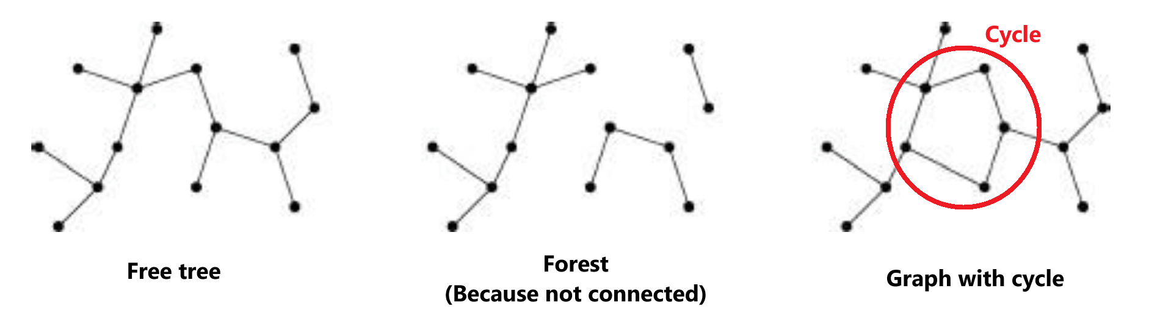
Trees,forests and graph identification
Image:²
²Cormen, Leiserson, Rivest, Stein. Introduction to Algorithms, 3rd edition, MIT Press, 2009
Trees Ch B.5, 10.4, 12.1

Slide 13
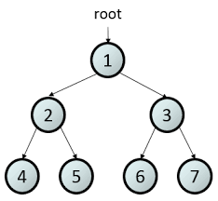
Rooted tree
A free tree in which one node is specially marked as root
In rooted trees, we can talk about parent, child, sibling, subtrees, leaves, internal nodes
Depth and height are defined for rooted trees
Image: https://sites.ualberta.ca/~rosanna/books/PDSA/chapter8/tree.html
Trees Ch B.5, 10.4, 12.1

Slide 14
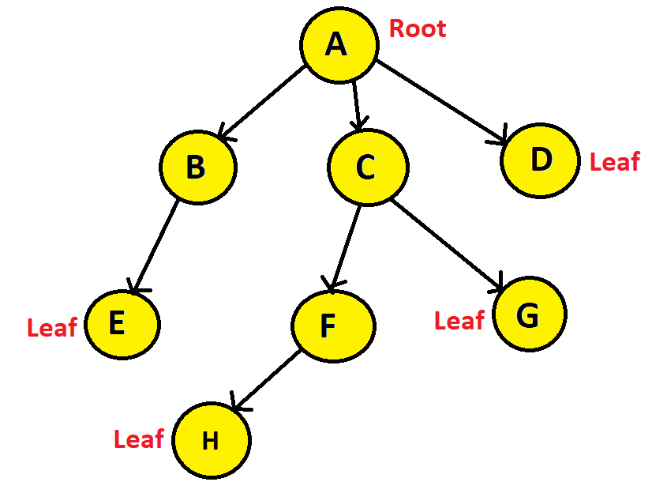
Terminology
Root node : Node without any parent, the topmost node.
If we have access to the root node, we have access to the entire tree.
(similar to head of linked list)
Leaf: A node without child / children
Trees Ch B.5, 10.4, 12.1
6/21

Slide 15
Terminology
Internal nodes: The root node and
the non-leaf nodes
has at least one child
Nodes A is root, and
B, C, and F are non-leaf nodes.
Thus, A, B, C, F are internal nodes.
Trees Ch B.5, 10.4, 12.1
7/21

Slide 16
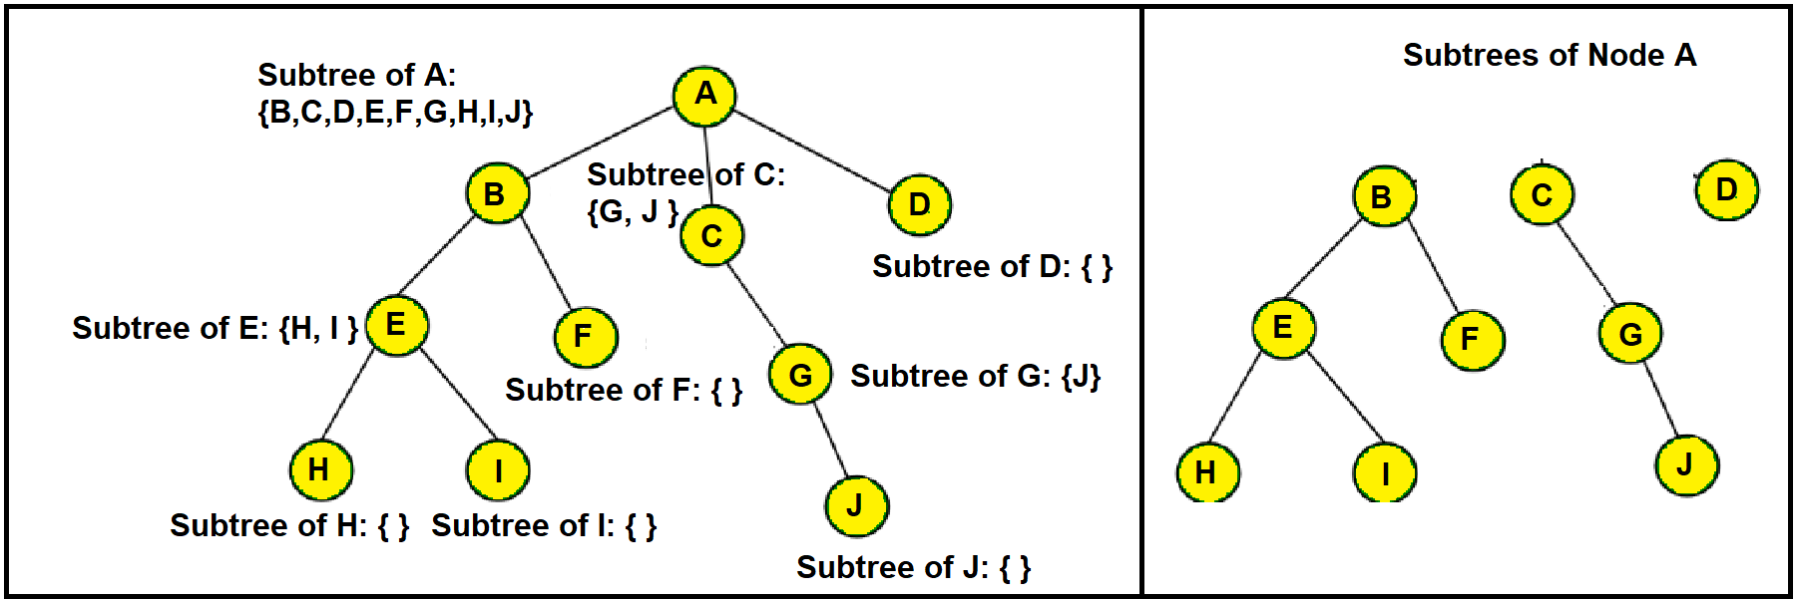
Terminology
Subtree: A tree that is the child of a Node.
Any tree can be further divided into subtrees with respect to a particular node.
Here, node A has three subtrees that are shown on the right side.
Trees Ch B.5, 10.4, 12.1
7/21

Slide 17
Terminology
Parent-Child node:
A is a parent of B and B is a child of A, if an edge points from A to B.
Any node can have only one parent
A parent, children: B, C, D
B parent, child: E
C parent, children: F, G
F parent, child: H
Trees Ch B.5, 10.4, 12.1
6/21

Slide 18
Terminology
Siblings: Two nodes having the same parent
A parent, Siblings: B, C, D
C parent, Siblings: F, G
Trees Ch B.5, 10.4, 12.1
6/21

Slide 19
Terminology
Edge: The link between two nodes.
If a tree has n number of nodes, it will have (n-1) number of edges.
Here, we have 8 nodes and 7 edges in total.
For a tree, no of edges == no of nodes - 1.
For a tree with n nodes, the number of edges is always n − 1.
More than n − 1 edges → creates at least one cycle.
Fewer than n − 1 edges → the graph becomes disconnected.
Trees Ch B.5, 10.4, 12.1
6/21

Slide 20
Terminology
Path: Consecutive edges from the source node to the destination node.
Question: Path from node A to E?
Trees Ch B.5, 10.4, 12.1
6/21

Slide 21
Terminology
Path: Consecutive edges from the source node to the destination node.
Question: Path from node A to E?
A→B→E.
Trees Ch B.5, 10.4, 12.1
6/21

Slide 22
Terminology
Degree: The total number of children of a node
The degree of node A is 3
The degree of node B is 1
The degree of node E is 0
The degree of node C is 2
The degree of node F is 1
The degree of node H is 0
The degree of node G is 0
The degree of node D is 0
Trees Ch B.5, 10.4, 12.1
6/21

Slide 23
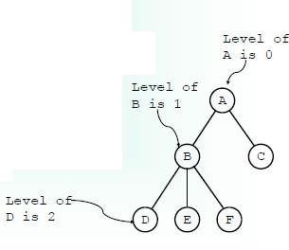
Depth/Level of a tree (Important!)
The level (or depth) of a node n is equal to
the number of edges from the root to that node
Image:⁵
⁵Brad Miller, David Ranum, Problem Solving with Algorithms and Data Structures, Release 3.0, 2013
Trees Ch B.5, 10.4, 12.1
8/21

Slide 24
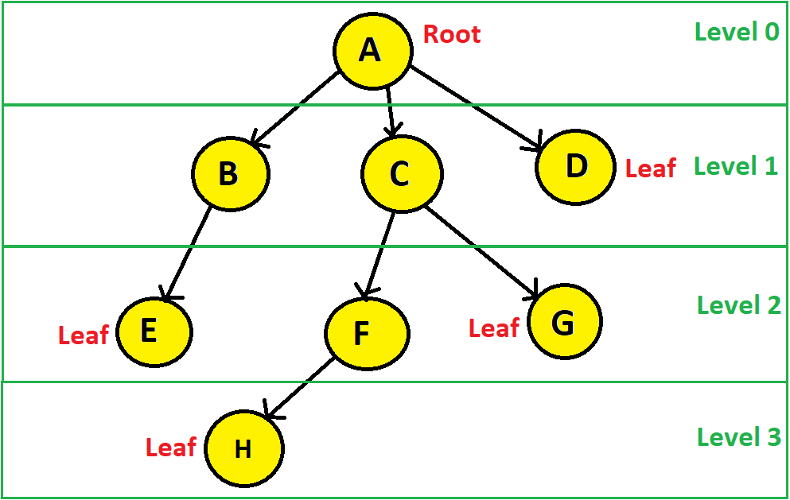
Depth/Level of a tree
The level (or depth) of a node n is equal to the number of edges from the root to that node
Trees Ch B.5, 10.4, 12.1
8/21

Slide 25
Height of a tree (Important!)
Height: The length of the longest path from a node to one of its leaf nodes
From node A to the leaf nodes there are four paths:
A→B→E (edges=2)
A→C→F→H (edges=3)
A→C→G (edges=2)
A→D (edges=1)
A→C→F→H is the longest path. (edges=3)
Hence, the height of Node A is 3.
Tree height means the height of Root
Image:⁶
⁶Brad Miller, David Ranum, Problem Solving with Algorithms and Data Structures, Release 3.0, 2013
Trees Ch B.5, 10.4, 12.1

Slide 26
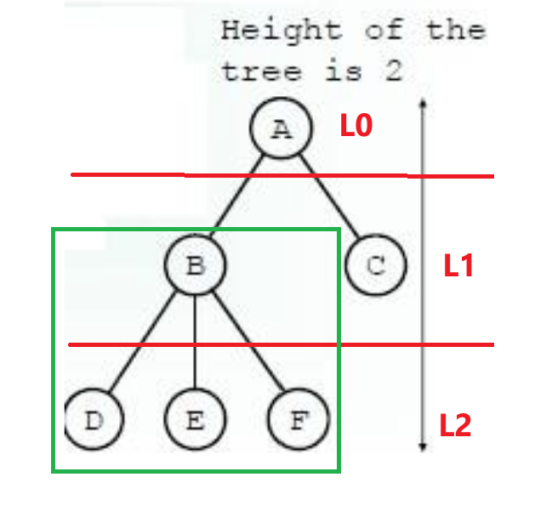
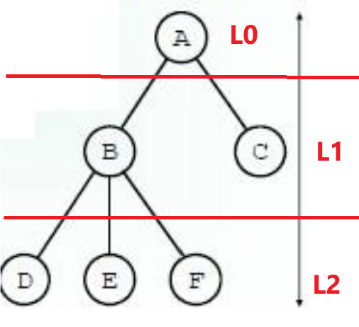
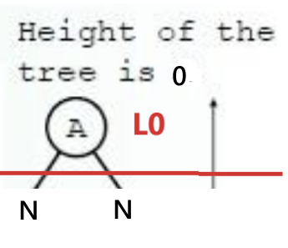
Height of a tree [This slide is needed for code]
Height: The length of the longest path from a node to one of its leaf nodes
  If a tree consist of only the root its height is 0
  Otherwise the height is 1 greater than the height of its tallest subtrees
Only 1 node, root=leaf
So, height = 0
height = 1+ height of tallest subtree (A has 2 subtrees)
= 1+ (Height of B to D/E/F)
= 1 + (1 + Height of D/E/F (single leaf node))
= 1 + (1 + 0)
= 1 + 1 = 2
Image:⁶
⁶Brad Miller, David Ranum, Problem Solving with Algorithms and Data Structures, Release 3.0, 2013
Trees Ch B.5, 10.4, 12.1

Slide 27
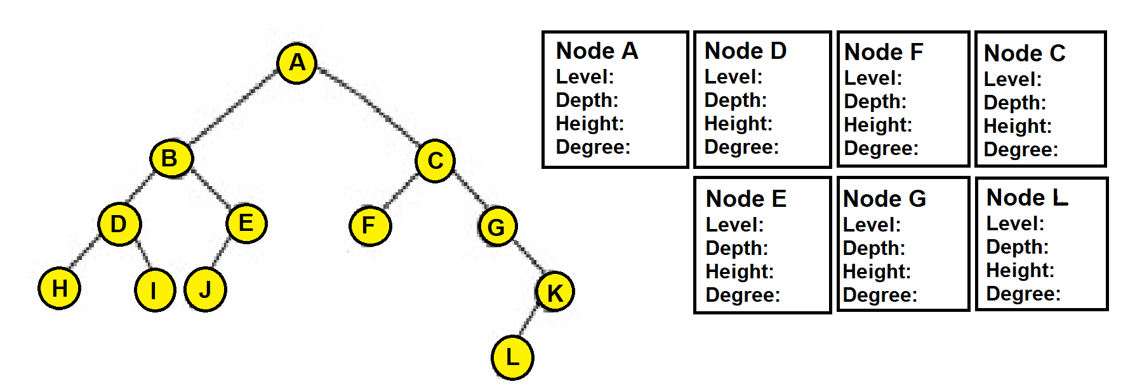
Home work
Find the level, depth, height and degree of the specified nodes of the following tree.
Trees Ch B.5, 10.4, 12.1

Slide 28
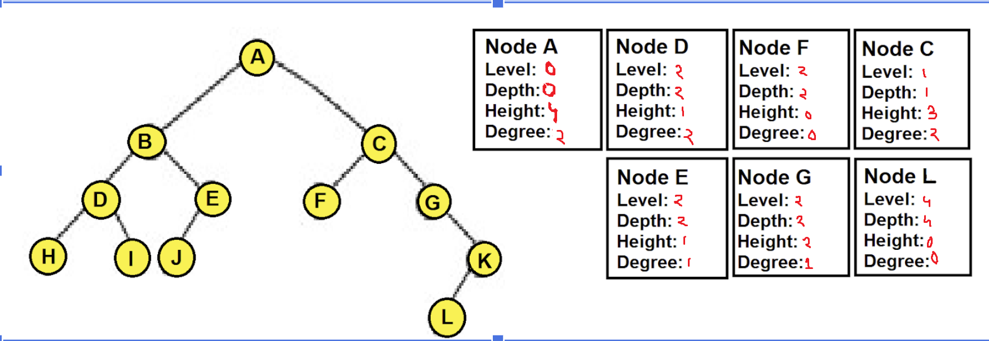
Home work
Depth/Level: no of edges in between root to selected node
Degree: no of children
Height: no of edges in between selected node to leaf node
Trees Ch B.5, 10.4, 12.1

Slide 29
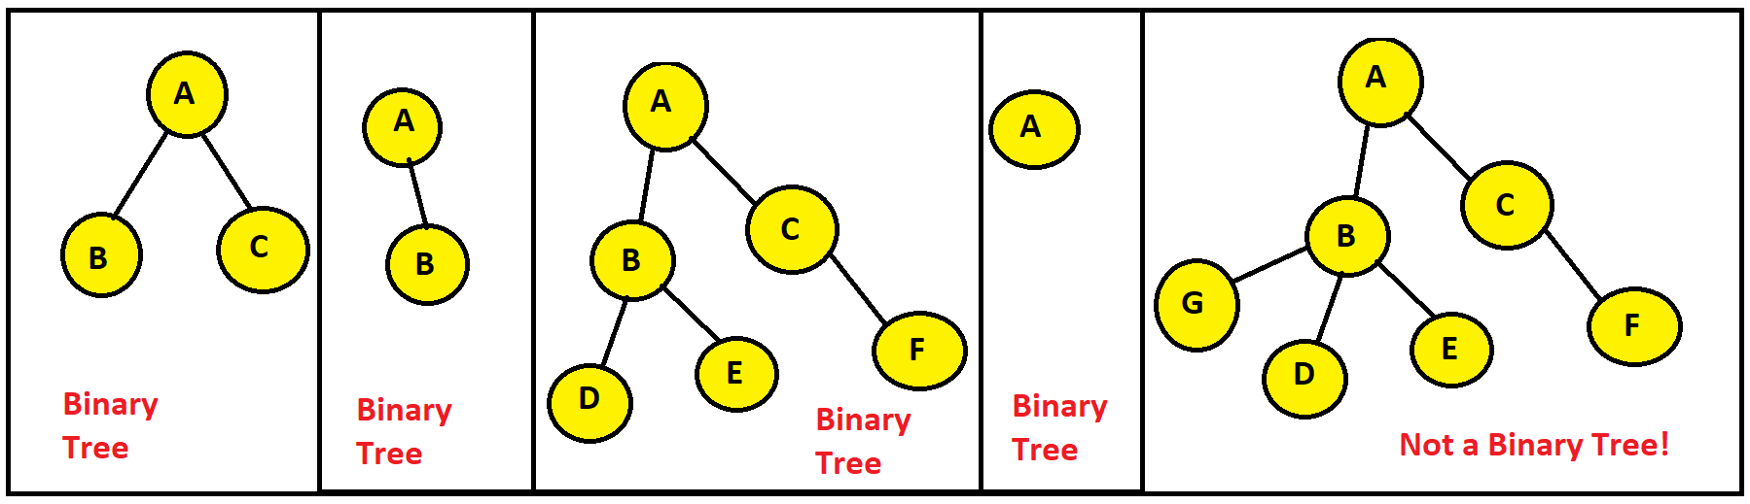
A binary tree
A tree is a binary tree if each node has at most 2 children. (0 child, 1 child or 2 children)
A binary tree is a rooted tree in which every node has at most two children.
A binary tree (BT) is a structure defined on a finite set of nodes that either
contains no nodes (empty tree), or
is composed of three disjoint sets of nodes:
  a root node
  a binary tree called left subtree
  a binary tree called right subtree
Important: The left and right subtrees are themselves also binary trees.
Trees Ch B.5, 10.4, 12.1

Slide 30
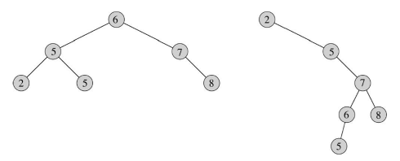
Binary Tree examples
²Cormen, Leiserson, Rivest, Stein. Introduction to Algorithms, 3rd edition, MIT Press, 2009

Slide 31
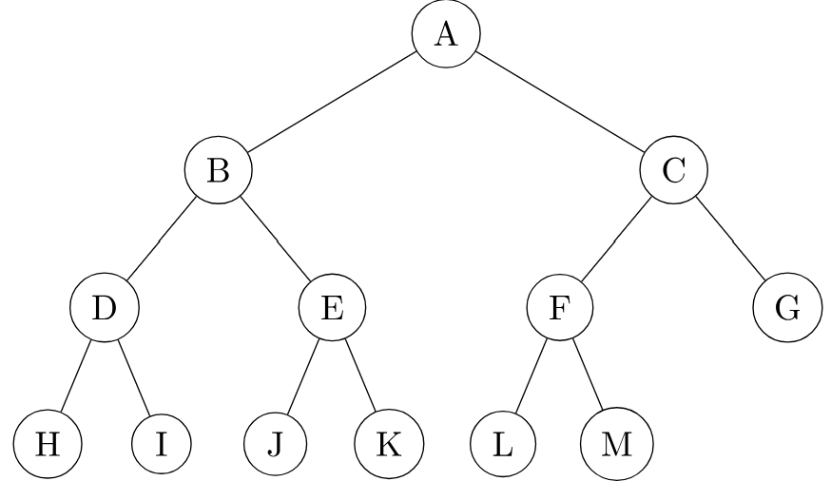
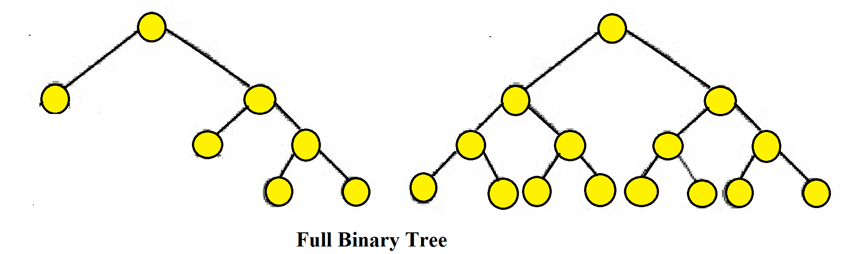
Types of Binary Tree
Full/Strict Binary Tree:
Internal nodes (every node except the leaf nodes) have two children.
every node has either 0 or 2 children
Any binary tree that maintains the following condition is a full binary tree:
No of leaf nodes = no of internal nodes + 1
In the left tree, there are 3 internal nodes and 4 leaf nodes. | In the middle tree, there are 7 internal nodes and 8 leaf nodes. | In the right tree, there are 6 internal nodes and 7 leaf nodes.
Trees Ch B.5, 10.4, 12.1

Slide 32
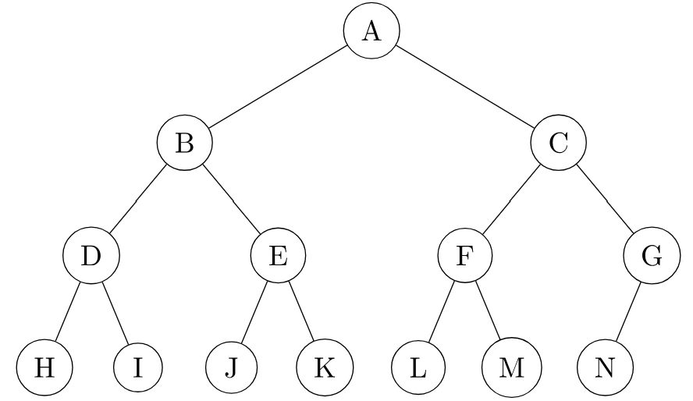
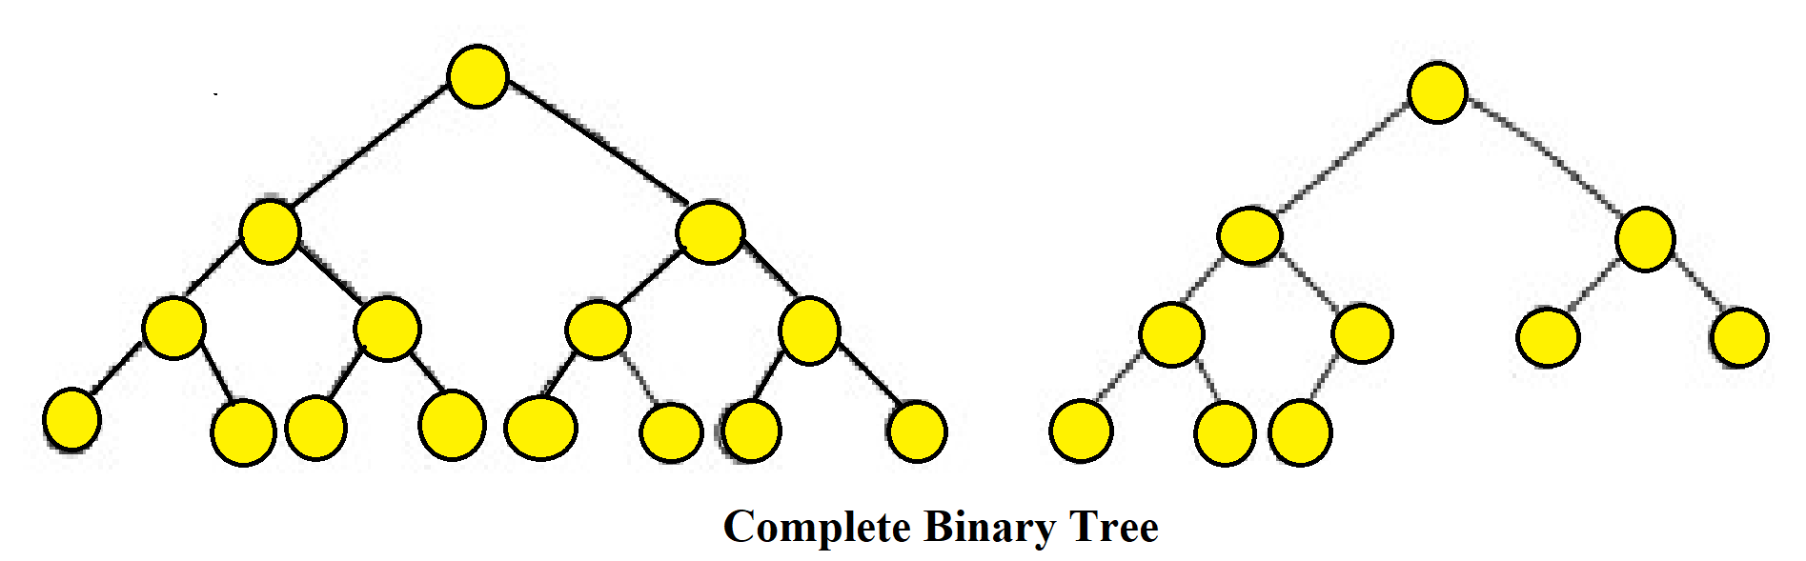
Types of Binary Tree
Complete Binary Tree:
All levels are completely filled except the lowest, every node should reside on the left side.
How can we identify a complete binary tree?
All internal nodes with two children.
If an internal node has one child, it must be on the left.
In the leftmost tree, all internal nodes have two children. | In the middle tree, all internal nodes except one have two children. The single internal node with one child has it on the left. | In the rightmost tree, all internal nodes except one have two children. The single internal node with one child has it on the left.
Trees Ch B.5, 10.4, 12.1

Slide 33
Full and complete binary tree
A complete binary tree is just like a full binary tree, but with two major differences
All the leaf elements must lean towards the left.
The last leaf element might not have a right sibling
i.e. a complete binary tree doesn't have to be a full binary tree.
Trees Ch B.5, 10.4, 12.1

Slide 34
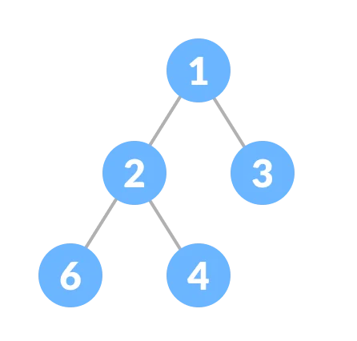
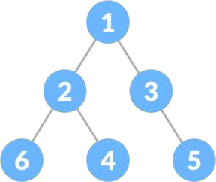
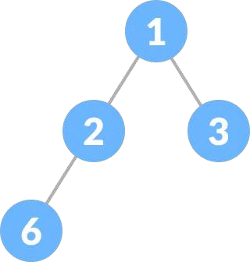
Full vs complete binary tree
Full/Strict Binary Tree:
  1) Every node has either 0 or 2 children.
  2) No of leaf nodes = no of internal nodes + 1
Complete Binary Tree:
  1) All internal nodes with two children.
  2) If an internal node has one child, it must be on the left.
Source: https://www.programiz.com/dsa/complete-binary-tree

Slide 35
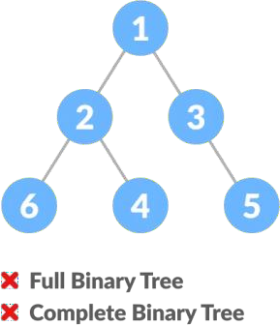
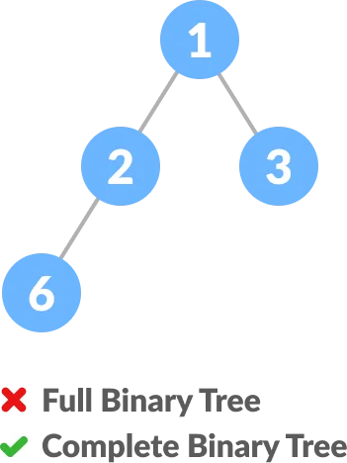
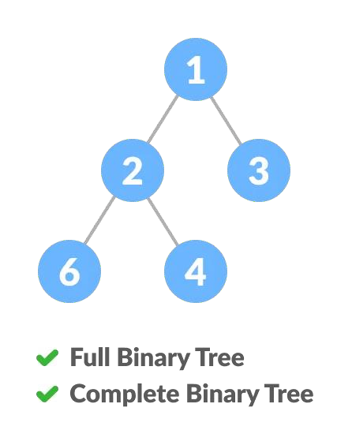
Full vs complete binary tree
Full/Strict Binary Tree:
  1) Every node has either 0 or 2 children.
  2) No of leaf nodes = no of internal nodes + 1
Complete Binary Tree:
  1) All internal nodes with two children.
  2) If an internal node has one child, it must be on the left.
Source: https://www.programiz.com/dsa/complete-binary-tree

Slide 36
Full vs complete binary tree
Full | Node 3 does not have 2 children | Node 2 does not have 2 children | Every node has either 0 or 2 children
Complete | node 3 is missing left child, and it has a right child, 5 | Node 1 has 2 child, node 3 does not have any child, node 2 has child on left side | All internal nodes (1, 2) has 2 children.
Source: https://www.programiz.com/dsa/complete-binary-tree

Slide 37
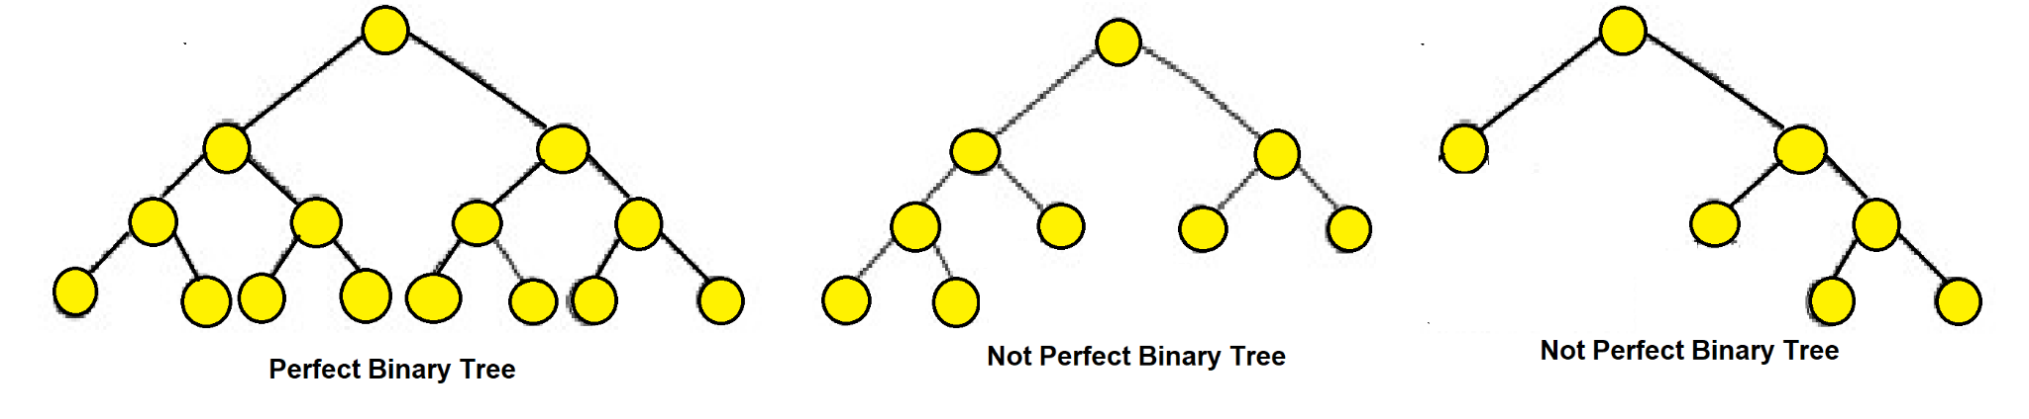
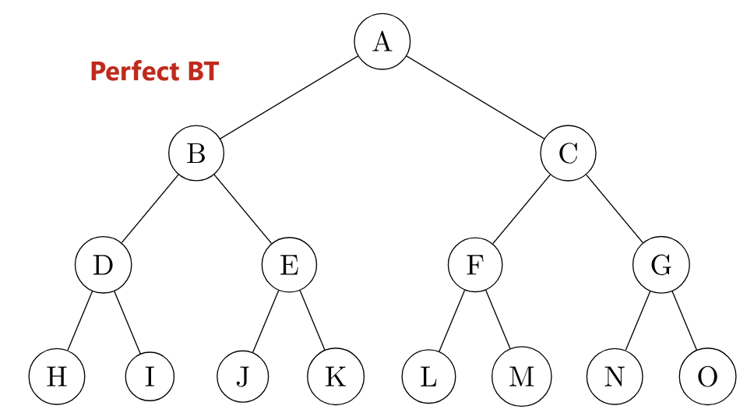
Types of Binary Tree
Perfect Binary Tree:
Every internal node has exactly two child nodes and
all the leaf nodes are at the same level.
In the middle tree, all the leaf nodes are not on the same level. | In the rightmost tree, all the leaf nodes are not on the same level.
Trees Ch B.5, 10.4, 12.1

Slide 38
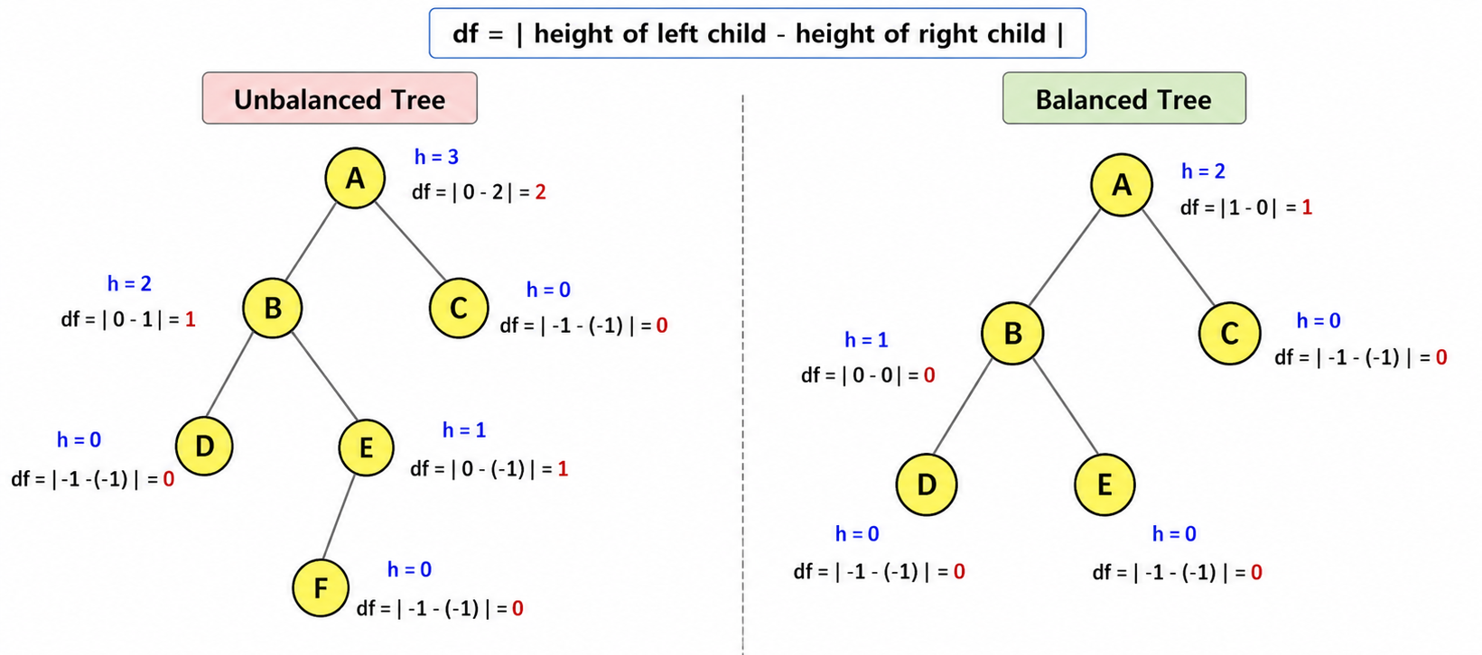
Types of Binary Tree
Balanced / Height-balanced Binary Tree:
The height of the left and right subtree of any node differ by not more than 1. (take absolute value).
Height: The length of the longest path from a node to one of its leaf nodes.
In the leftmost tree, the height of Node A’s left subtree is 2 and right subtree is 0. Therefore, the difference between these two is 2. | In the rightmost tree, no nodes have a height difference of more than 1 in between their left and right subtrees.
Trees Ch B.5, 10.4, 12.1

Slide 39
Types of Binary Tree
Balanced / Height-balanced Binary Tree:
The height of the left and right subtree of any node differ by not more than 1. (take absolute value).
Height: The length of the longest path from a node to one of its leaf nodes.
Always start checking from leaf nodes
When df>1,
say not balanced and STOP
(df=0, 1 acceptable)
If left or right subtree is missing, consider the height of that subtree to be -1
In the leftmost tree, the height of Node A’s left subtree is 2 and right subtree is 0. Therefore, the difference between these two is 2. | In the rightmost tree, no nodes have a height difference of more than 1 in between their left and right subtrees.
Trees Ch B.5, 10.4, 12.1

Slide 40
Types of Binary Tree
Full/Strict Binary Tree:
  1) Every node has either 0 or 2 children.
  2) No of leaf nodes = no of internal nodes + 1
Complete Binary Tree:
  1) All internal nodes with two children.
  2) If an internal node has one child, it must be on the left.
Perfect Binary Tree:
  1) Every internal node has exactly two child nodes and
  2) all the leaf nodes are at the same level.
Balanced/ Height-balanced Binary Tree:
  The height of the left and right subtree of any node differ by not more than 1.
Trees Ch B.5, 10.4, 12.1

Slide 41
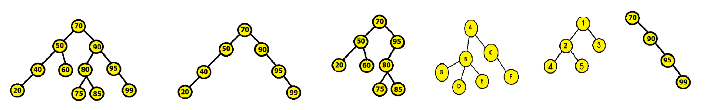
Types of Binary Tree (Homework)
Full/Strict Binary Tree:
  1) Every node has either 0 or 2 children.
  2)No of leaf nodes = no of internal nodes + 1
Complete Binary Tree:
  1) All internal nodes with two children.
  2) If an internal node has one child, it must be on the left.
Perfect Binary Tree:
  1) Every internal node has exactly two child nodes and
  2) all the leaf nodes are at the same level.
Balanced/ Height-balanced Binary Tree:
  The height of the left and right subtree of any node differ by not more than 1.
QUESTION: Identify which of the following trees are full, complete, perfect and balanced.
Trees Ch B.5, 10.4, 12.1

Slide 42
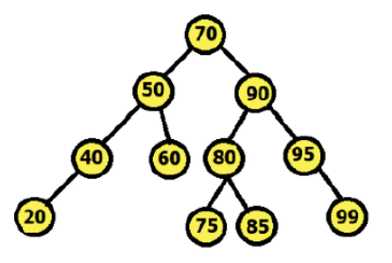
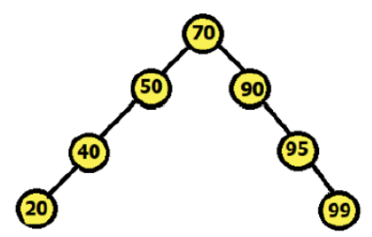
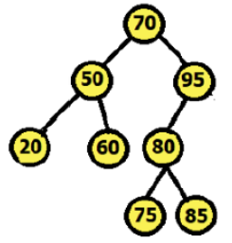
Identify Types of Binary Tree (Homework)
Full | Internal nodes 40 and 95 have 1 children. So, not full | Except for 70, all nodes have 1 or 0 children. So, not full | Node 95 has 1 children. So, not full
Complete | 95 which is an internal node has 1 child which is on right. So, not complete | 95 which is an internal node has 1 child which is on right. So, not complete | A complete tree would not have missing nodes on the left before filling right; here there are gaps. So, not complete
Perfect | Internal nodes 40 and 95 have 1 children. So, not Perfect | Internal nodes (59, 40, 90, 95) have 1 children. So, not Perfect | Internal node 95 have 1 children. Not all leaves on same level. So, not Perfect
balanced | Yes | No | No
Trees Ch B.5, 10.4, 12.1

Slide 43
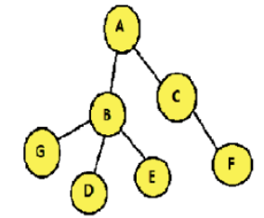
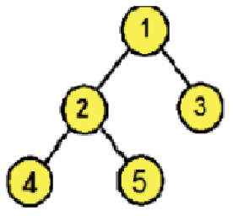
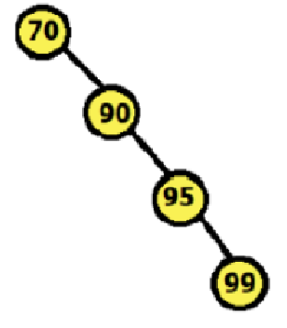
Identify Types of Binary Tree (Homework)
Full | Not a binary tree. B has 3 children | all nodes have 2 or 0 children. So, full | all internal nodes have 1 children. So, not full
Complete | Not a binary tree. B has 3 children | internal nodes (1, 2) have 2 children. So, complete | 95 which is an internal node has 1 child which is on right. So, not complete
Perfect | Not a binary tree. B has 3 children | Internal nodes (1, 2) have 2 children. But leaf nodes (4, 5, 3) are not on same level. So, not Perfect | Internal nodes (70, 90, 95) have 1 children. So, not Perfect
balanced | Not a binary tree. B has 3 children | Yes | No
Trees Ch B.5, 10.4, 12.1

Slide 44
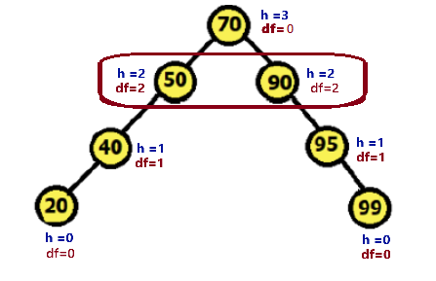
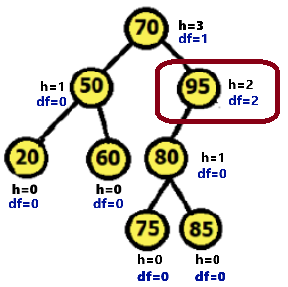
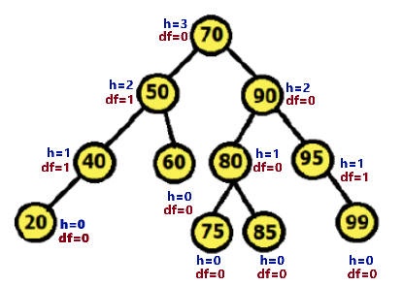
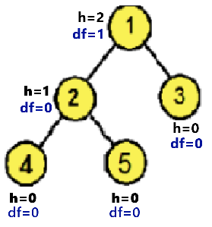
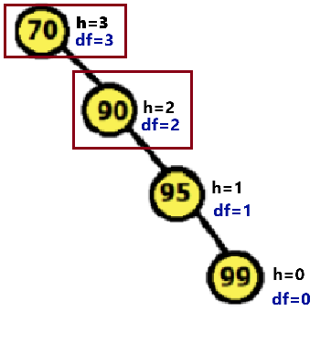
Check Balanced Binary tree (Homework)
If left or right subtree is missing, consider the height of that subtree to be -1
You need to show, for which nodes the BT became unbalanced.
Trees Ch B.5, 10.4, 12.1

Slide 45
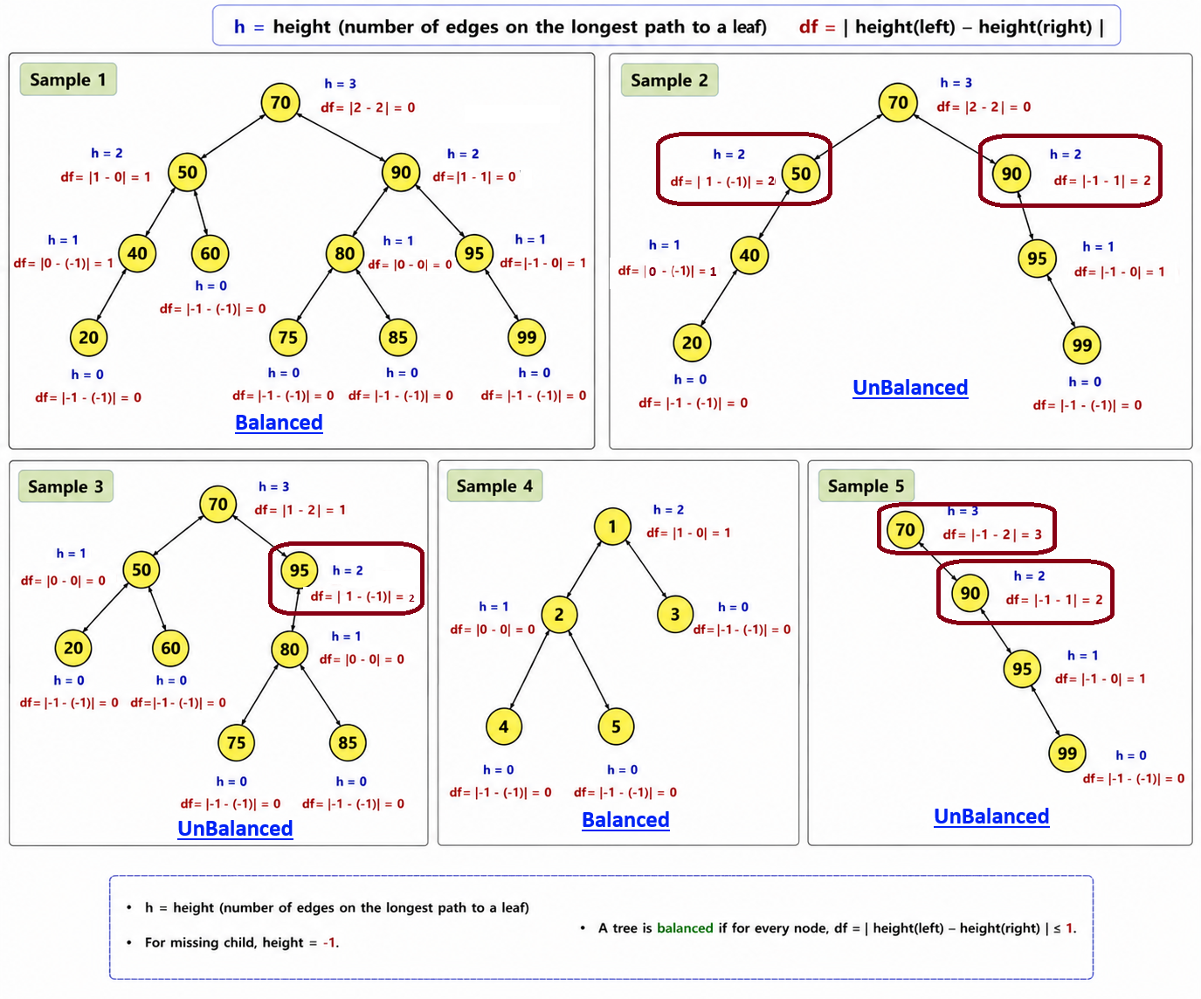
Check Balanced Binary tree (Homework)

Slide 46
Characteristics of a Binary Tree
Each node can have at most two child nodes
Node Relationships: (Applicable for only Extended Binary Tree)
Internal nodes: n
External nodes: n+1
Total edges: 2n
Internal edges: n−1
External edges: n+1
Binary Tree Properties: (Important remember)
Max nodes in height h: 2^(h+1)−1
Max nodes at level i: 2^i
Trees Ch B.5, 10.4, 12.1

Slide 47
What is an Extended Binary Tree?
Original Binary Tree
Extended Binary Tree
Definition
A
A
•
An extended binary tree is a transformation of any binary tree into a full binary tree representation.
(Not always complete)
replace NULL
B
C
B
C
•
It replaces every NULL subtree / missing child with a special external node (dummy nodes).
D
X1
X2
E
D
E
•
Nodes from the original tree become internal nodes.
X3
X4
X5
X6
•
The added special nodes become external nodes.
Some child positions are NULL / missing.
External nodes are leaves.
Full/Strict Binary Tree:
1) Every node has either 0 or 2 children.
2) No of leaf nodes = no of internal nodes + 1
Source:
https://www.geeksforgeeks.org/dsa/extended-binary-tree/
https://www.thedshandbook.com/binary-trees/
Binary Tree Basics • 4

Slide 48
Relationship Formulas in an Extended Binary Tree (Example 1)
Internal edge
A
Worked Example
Connects one internal node to another internal node.
•
Internal nodes = n = 3 (A, B, C)
B
C
•
External nodes = n+1 = 4 (X1–X4)
•
Internal edges = = n − 1 = 3 - 1 = 2
X1
X2
X3
X4
•
External edges = n+1 =3+ 1 = 4
External edge
Connects an internal node to an external node.
•
Total edges = 2n =2x3= 6
Binary Tree Basics • 5

Slide 49
Relationship Formulas in an Extended Binary Tree (Example 2)
Original Binary Tree
Extended Binary Tree
Formula Summary
Level 0
A
A
Internal nodes
= n = 4
B
C
External nodes
= n + 1 = 5
Level 1
B
C
D
X1
X2
X3
Total edges
= 2n = 8
Level 2
D
X4
X5
Internal edges
= n − 1 = 3
External edges
= n + 1 = 5
NULL positions become external leaf nodes X1–X5.
Binary Tree Basics • 7

Slide 50
Relationship Formulas in an Extended Binary Tree (example3)
A
Formula Summary
B
C
Internal nodes
= n = 5
D
X1
X2
E
External nodes
= n + 1 = 6
Total edges
= 2n = 2x5 = 10
X3
X4
X5
X6
Internal edges
= n − 1 = 5 - 1= 4
Why total edges = 2n?
Every internal node has exactly two children in the extended tree.
So each internal node contributes 2 outgoing child edges.
External edges
= n + 1 = 5+ 1 = 6
Why internal edges = n − 1?
Among original/internal nodes, every node except the root has exactly one parent. So internal edges = internal nodes − 1.
Why external edges = n + 1?
External edges are the remaining child edges: 2n − (n − 1) = n + 1.
Binary Tree Basics • 6

Slide 51
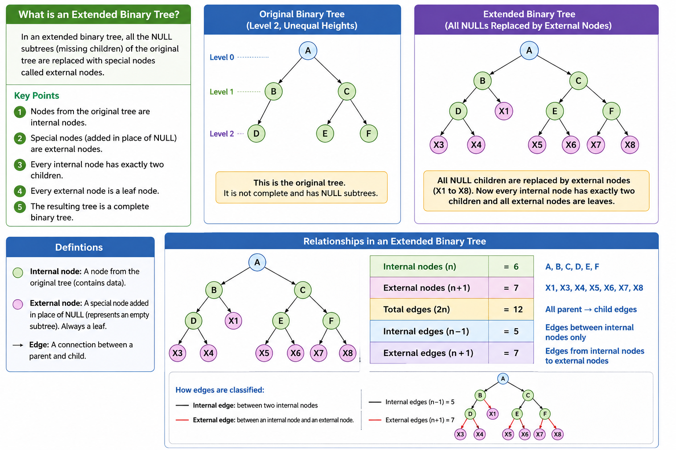

Slide 52
Binary Tree Properties (Important remember!!)
1
Level 0: 1
Must Remember
•
Max nodes at level i = 2ⁱ
2
3
Level 1: 2
•
Max nodes in height h = 2^(h+1) − 1
4
5
6
7
Level 2: 4
•
Min array length in height h = 2^(h+1)
•
Each new level can have twice as many nodes as the previous level.
8
9
10
11
12
13
14
15
Level 3: 8
Memory trick: levels grow as 1, 2, 4, 8, ...
If h = 3, max nodes = 2^(3+1) − 1 = 2^4 − 1 =15
If h = 3, min array length = 2^(3+1) = 2^4 =16
Binary Tree Basics • 8

Slide 53
Binary tree representation
There are two ways to represent binary trees:
Dynamic Representation (Using Linked List)
Sequential Representation (Using Array)
Representing rooted trees

Slide 54
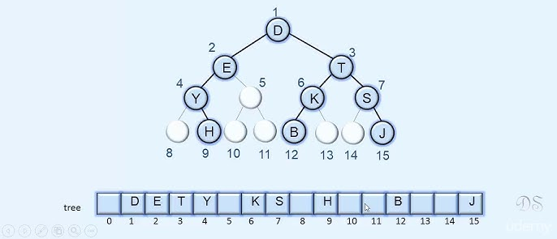
Sequential Representation (Using Array)
Max array length in height h: 2^(h+1)
Max nodes in height h: 2^(h+1)−1
Here, h = 3
Max array length: 2^(3+1) = 2^4 =16
Max nodes: 2^(3+1) - 1 = 2^4 -1 =15
left=2*i
right= 2*i+1
i= parent_index
parent = child_index//2
[floor division]
Image:⁸
⁸https://www.youtube.com/watch?v=0iHD18D072c

Slide 55
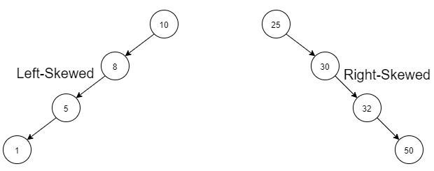
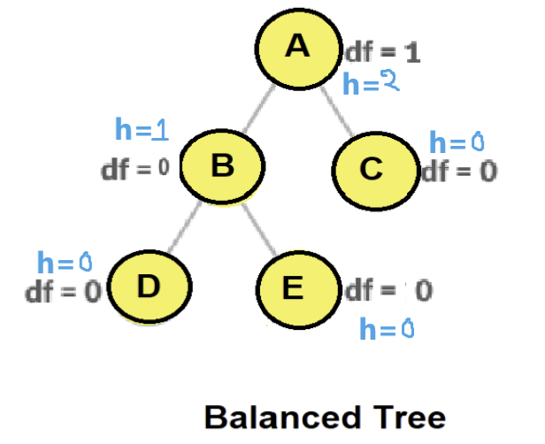
Sequential Representation (Using Array)
Balanced Binary Tree: Left and right subtrees are kept roughly equal in height
  Ensures optimal performance.
Unbalanced Binary Tree: Height difference between subtrees increases
  In the worst case, the tree becomes completely skewed
Skewed Binary Tree: Most nodes have only one child,
  Forms a linear, linked-list–like structure
Image:⁸
⁸https://www.youtube.com/watch?v=0iHD18D072c

Slide 56
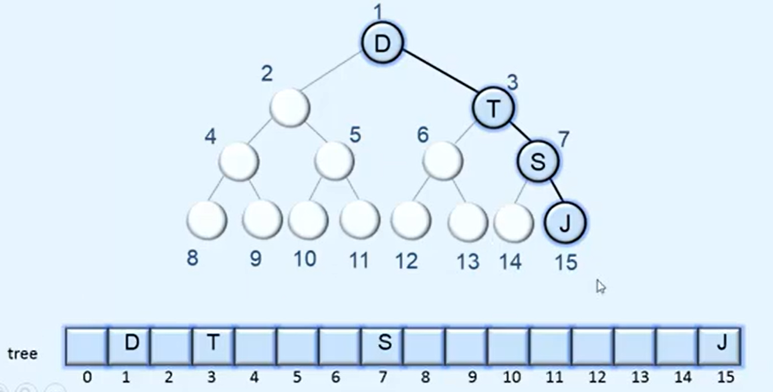
Sequential Representation (Using Array)
left=2*i
right= 2*i+1
i= parent_index
parent = child_index//2
[floor division]
Max array length in height h: 2^(h+1)
Max nodes in height h: 2^(h+1)−1
Here, h = 3
Max array length: 2^(3+1) = 2^4 =16
Max nodes: 2^(3+1) - 1 = 2^4 -1 =15
Problem: A left/right skewed binary tree has many empty array slots.
(Memory wastage)
Image:⁸
⁸https://www.youtube.com/watch?v=0iHD18D072c

Slide 57
Dynamic Representation (Using Linked List)
Each node has two child references (link): left and right.
If a node has fewer than two children,
the unused child reference is set to NIL (Null/None).

Slide 58
Dynamic Representation (Using Linked List)
Binary tree Node class design
Style01 | Style02
a reference to its left child (may be NIL) a reference to its right child (may be NIL) a key/value | a reference to its parent (NIL for root) a reference to its left child (may be NIL) a reference to its right child (may be NIL) a key/value

Slide 59
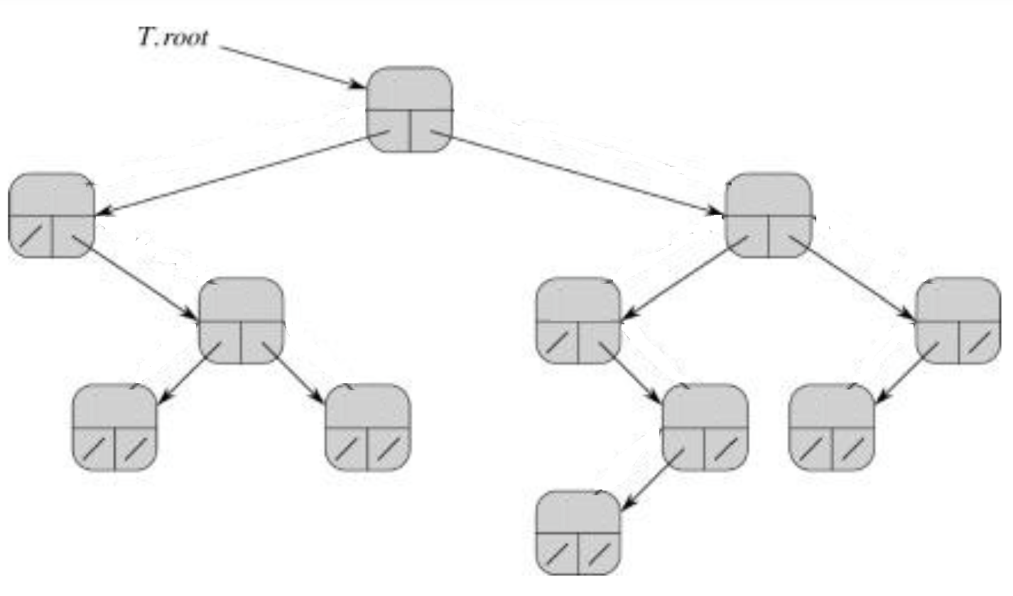
Dynamic Representation (Using Linked List) (style1)
Node class structure (style 1)
a reference to its left child a reference to its right child a key/value
Traversal: • Only downward (left/right) • No upward path to root
Problem: • Cannot go upward
Image:⁸
⁸Cormen, Leiserson, Rivest, Stein. Introduction to Algorithms, 3rd edition, MIT Press, 2009

Slide 60
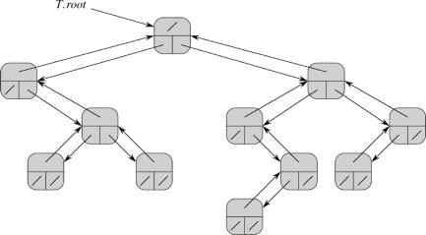
Dynamic Representation (Using Linked List) (style2)
Node class structure (style 2)
a reference to its parent a reference to its left child a reference to its right child a key/value
Traversal: Downward (left/right) Upward to root via parent
Problem: • Requires extra memory to keep parent
Image:⁸
⁸Cormen, Leiserson, Rivest, Stein. Introduction to Algorithms, 3rd edition, MIT Press, 2009

Slide 61
Navigating trees
Requirements
Each tree has exactly one root
Each node of the tree has exactly one parent
  Except root, which has no parent
Starting from the root, there is (at least) one way to reach each/every node in a tree
The root of the tree can be reached from any node
Representing rooted trees

Slide 62
Tree Traversal (Important!!!)
For Inorder, you traverse from the left subtree to the root then to the right subtree.
For Preorder, you traverse from the root to the left subtree then to the right subtree.
For Post order, you traverse from the left subtree to the right subtree then to the root.
Inorder => Left, Root, Right.
Preorder => Root, Left,Right.
Post order => Left, Right, Root.
Binary trees Ch 12.2–3

Slide 63

Tree Traversal (In order)
For Inorder, you traverse from the left subtree to the root then to the right subtree.
For Preorder, you traverse from the root to the left subtree then to the right subtree.
For Post order, you traverse from the left subtree to the right subtree then to the root.
Inorder => Left, Root, Right.
Preorder => Root, Left,Right.
Post order => Left, Right, Root.
Binary trees Ch 12.2–3

Slide 64

Tree Traversal (In order)
For Inorder, you traverse from the left subtree to the root then to the right subtree.
For Preorder, you traverse from the root to the left subtree then to the right subtree.
For Post order, you traverse from the left subtree to the right subtree then to the root.
Inorder => Left, Root, Right.
Preorder => Root, Left,Right.
Post order => Left, Right, Root.
Inorder answer:Homework
–solve it own your own
Binary trees Ch 12.2–3

Slide 65
Tree Traversal (In order)
For Inorder, you traverse from the left subtree to the root then to the right subtree.
For Preorder, you traverse from the root to the left subtree then to the right subtree.
For Post order, you traverse from the left subtree to the right subtree then to the root.
Inorder => Left, Root, Right.
Preorder => Root, Left,Right.
Post order => Left, Right, Root.
Inorder answer:
Binary trees Ch 12.2–3

Slide 66

Tree Traversal (Pre-order)
For Inorder, you traverse from the left subtree to the root then to the right subtree.
For Preorder, you traverse from the root to the left subtree then to the right subtree.
For Post order, you traverse from the left subtree to the right subtree then to the root.
Inorder => Left, Root, Right.
Preorder => Root, Left,Right.
Post order => Left, Right, Root.
Binary trees Ch 12.2–3

Slide 67

Tree Traversal (Pre-order)
For Inorder, you traverse from the left subtree to the root then to the right subtree.
For Preorder, you traverse from the root to the left subtree then to the right subtree.
For Post order, you traverse from the left subtree to the right subtree then to the root.
Inorder => Left, Root, Right.
Preorder => Root, Left,Right.
Post order => Left, Right, Root.
Preorder answer:Homework
–solve it own your own
Binary trees Ch 12.2–3

Slide 68
Tree Traversal (Pre-order)
For Inorder, you traverse from the left subtree to the root then to the right subtree.
For Preorder, you traverse from the root to the left subtree then to the right subtree.
For Post order, you traverse from the left subtree to the right subtree then to the root.
Inorder => Left, Root, Right.
Preorder => Root, Left,Right.
Post order => Left, Right, Root.
Preorder answer:
Binary trees Ch 12.2–3

Slide 69

Tree Traversal (post order)
For Inorder, you traverse from the left subtree to the root then to the right subtree.
For Preorder, you traverse from the root to the left subtree then to the right subtree.
For Post order, you traverse from the left subtree to the right subtree then to the root.
Inorder => Left, Root, Right.
Preorder => Root, Left,Right.
Post order => Left, Right, Root.
Binary trees Ch 12.2–3

Slide 70

Tree Traversal (post order)
For Inorder, you traverse from the left subtree to the root then to the right subtree.
For Preorder, you traverse from the root to the left subtree then to the right subtree.
For Post order, you traverse from the left subtree to the right subtree then to the root.
Inorder => Left, Root, Right.
Preorder => Root, Left,Right.
Post order => Left, Right, Root.
Post order answer:Homework
–solve it own your own
Binary trees Ch 12.2–3

Slide 71
Tree Traversal (post order)
For Inorder, you traverse from the left subtree to the root then to the right subtree.
For Preorder, you traverse from the root to the left subtree then to the right subtree.
For Post order, you traverse from the left subtree to the right subtree then to the root.
Inorder => Left, Root, Right.
Preorder => Root, Left,Right.
Post order => Left, Right, Root.
Post order answer:
Binary trees Ch 12.2–3

Slide 72

Tree Traversal (Home work)
–solve it own your own
Binary trees Ch 12.2–3

Slide 73
Tree Traversal (Home work)
Binary trees Ch 12.2–3

Slide 74

Home work
Inorder => Left, Root, Right.
Preorder => Root, Left, Right.
Post order => Left, Right, Root.
Image:²
²https://www.geeksforgeeks.org
28/24

Slide 75
Home work
Inorder => Left, Root, Right. (4 10 12 | 15| 18 22 24| 25| 31 35 44| 50| 66 70 90)
Preorder => Root, Left, Right. (25 15 10| 4 12 | 22 18 24 | 50| 35| 31 44| 70 66 90)
Post order => Left, Right, Root. (4 12 10 | 18 24 22| 15 | 31 44| 35| 66 90 70| 50 25)
Image:²
²https://www.geeksforgeeks.org
28/24

Slide 76

Home work
Inorder => Left, Root, Right.
Preorder => Root, Left, Right.
Post order => Left, Right, Root.
28/24

Slide 77

Home work
28/24

Slide 78
Try out Interactive Simulation by Visualgo.net (https://visualgo.net/en/bst)
Interactive simulations

Slide 79
Recordings:
https://www.youtube.com/playlist?list=PLVMWGcuvXYt0

Slide 80
The End

